Slide 1
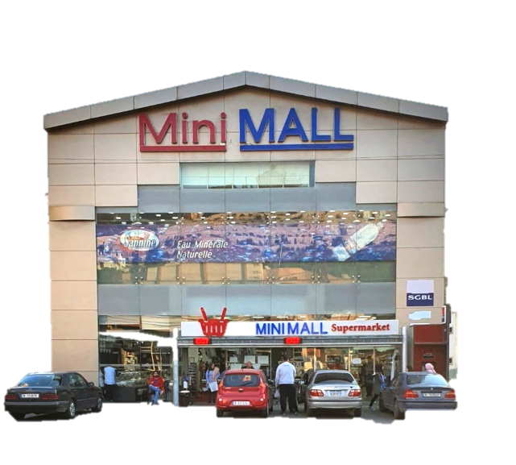
Customer Segmentation at MiniMall
Samer Haidar
Mazen Hajj Diab
Sara Malaeb
December 8, 2020

Slide 2

Overview
1
Introduction
2
Problem Description
3
Data Collection and Description
4
Models
5
Results and Discussion
Conclusion and Recommendation
6

Slide 3
1
Introduction

Slide 4


Description of the company:
MINI MALL supermarket
General info
Products offered
Three-story supermarket
Founded in 2007
Located in Zibdine, Nabatiyeh
Mini Mall finances: $4 million revenue per 6 months
Wide variety of high-quality products ranging from dairy, frozen, and canned products, to confectionary and beverages, organized into sections and shelves.

Slide 5
2
Problem Description

Slide 6

Problem Description
1- Classifying customers as light or heavy users
2- Building a customer recommendation system
Data can be leveraged to detect trends and similarities in customers’ purchasing behaviors
It is essential to segment customers to better initiate advertising and marketing campaigns tailored to these different segments
Bad Economic Situation, Covid-19 Pandemic, Fierce Competition

Slide 7
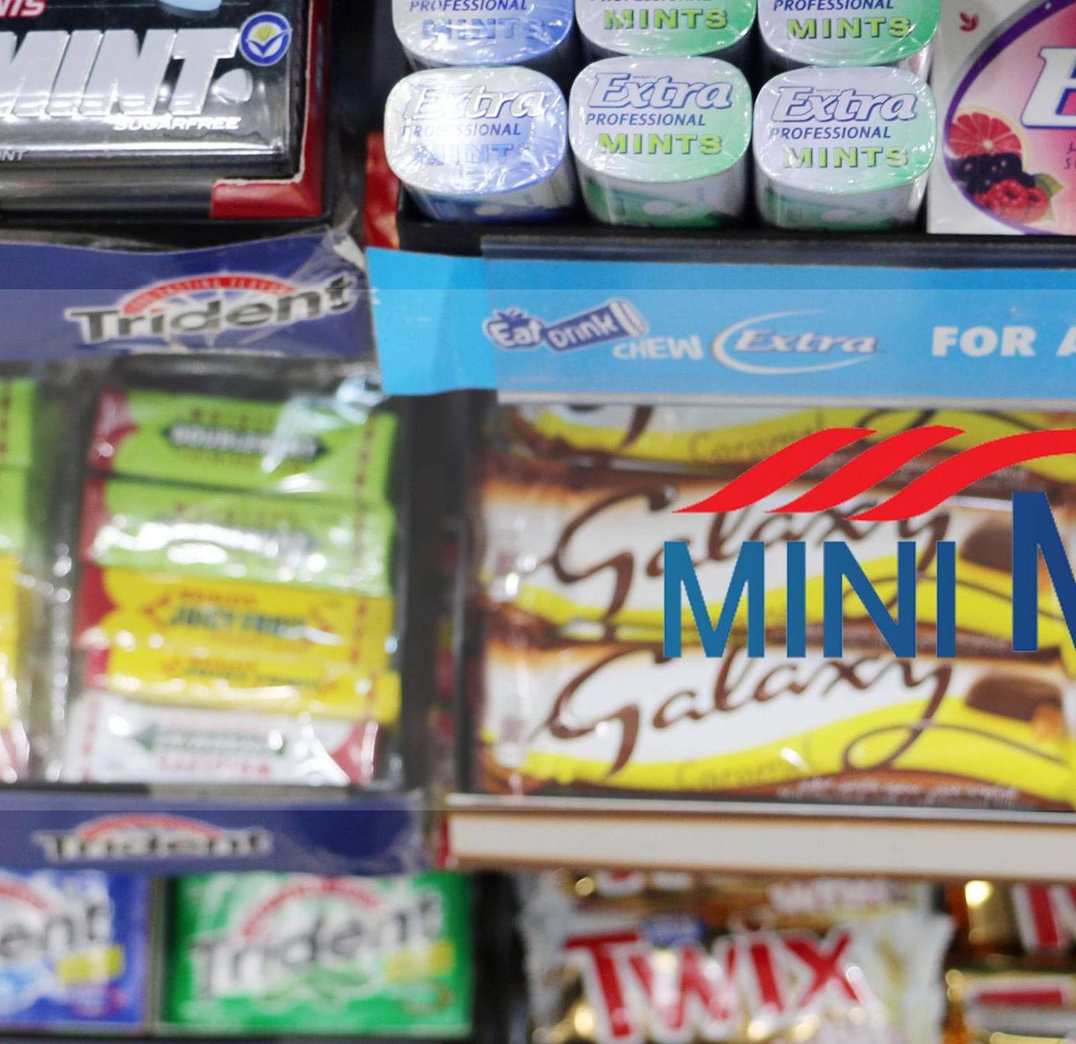
Data Collection and
Description
3

Slide 8
Methodology
September Data
Customer September Data
Customer September Data with Labels
Data
October Data
Customer Data
Labels

Slide 9
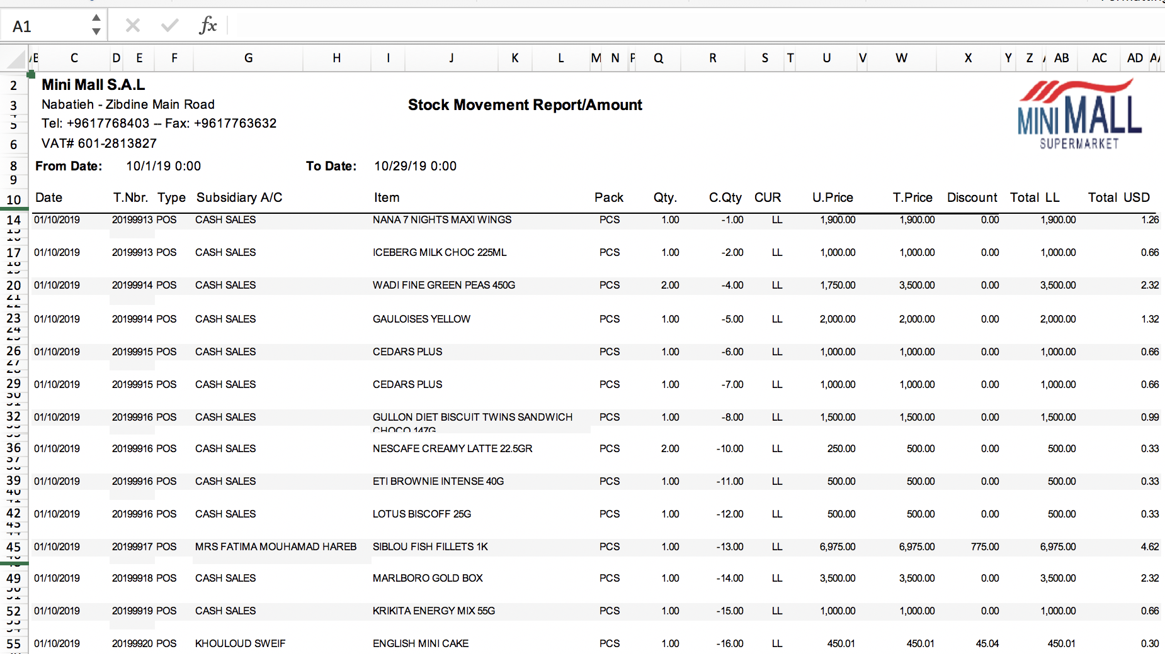
Customers’ Invoices
Data collected
A sample of the 51,379 e-receipts collected from the owner

Slide 10
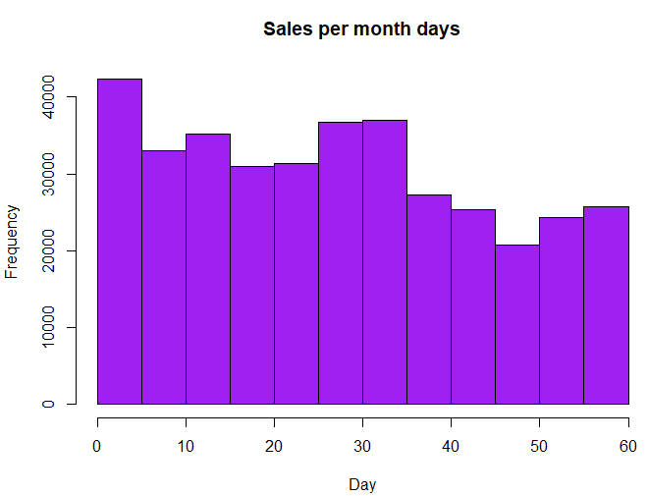
Sales Histogram
Sales during September and October 2019

Slide 11
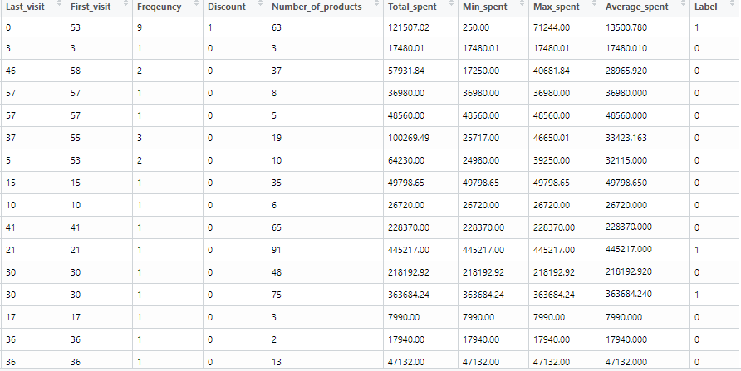
Customer Data
Customer Data Collected:
3219 Customers

Slide 12
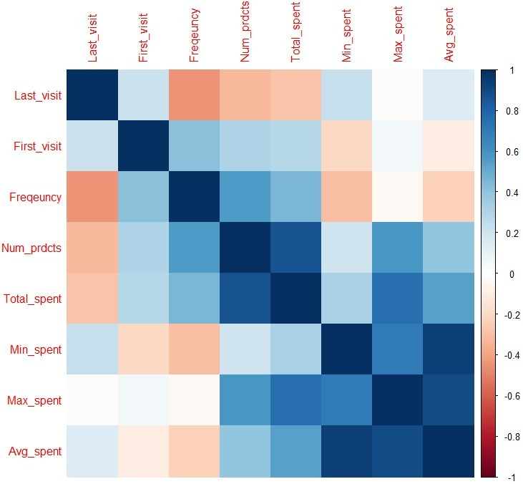
Visualizing the Data
Correlation Heat Map
Correlation between independent variables:
Average Spent and Min Spent are highly correlated
Total Spent and Number of Products Bought are also highly correlated

Slide 13
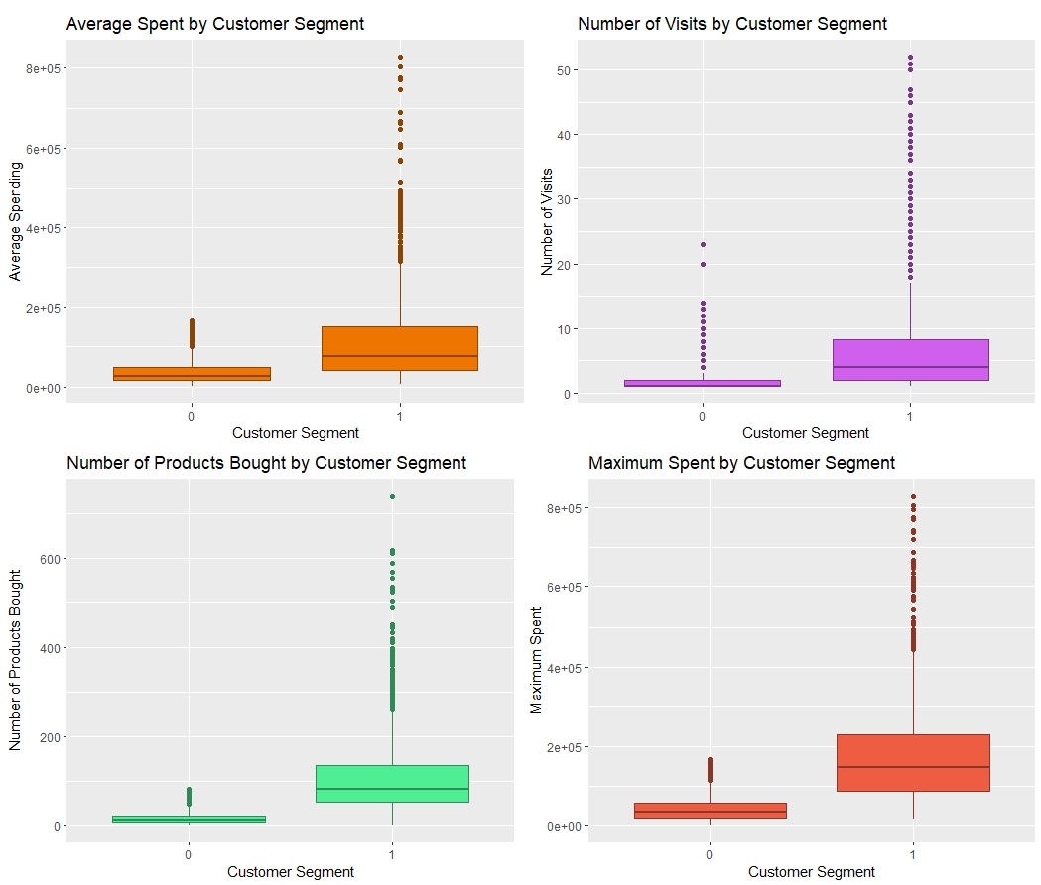
Determining associations
Side-by-Side Boxplots
It is obvious that there is a significant association between the category of the customers (Light Customers represented by ‘0’ and Heavy Customers represented by ‘1’) and each of the other independent variables.

Slide 14
Spending and Frequency of Visits by Segment
Customer | Sum | Min | Max | Mean
Light | 83,196,914 | 500 | 166,564 | 58,139
Heavy | 747,938,651 | 113,626 | 1,945,533 | 418,310
Average Spent
Light customers spend 58, 139 LL on average, while heavy customers spend 418, 310 LL on average
Customer | Sum | Min | Max | Mean
Light | 2968 | 1 | 23 | 2.07
Heavy | 12241 | 1 | 52 | 6.84
Number of Visits
Light customers visit 2 times on average, while heavy customers visit 7 times on average

Slide 15
4
Modeling

Slide 16

Logistic Classifiers
Label ~ Number_of_products + Last_visit + First_visit + Average_spent + Discount + Min_spent + Max_spent + Freqeuncy
Model 1
Model 2
Label ~ Number_of_products + Last_visit + First_visit + Discount + Min_spent + Max_spent + Freqeuncy
Model | Number of Products | Last Visit | First Visit | Average Spent | Discount | Min Spent | Max Spent | Frequency
Model 1 | 1.863 | 2.545 | 2.357 | 206.765 | 1.186 | 82.196 | 40.392 | 3.329
Model 2 | 1.832 | 2.512 | 2.321 | - | 1.174 | 5.282 | 4.595 | 2.989

Slide 17
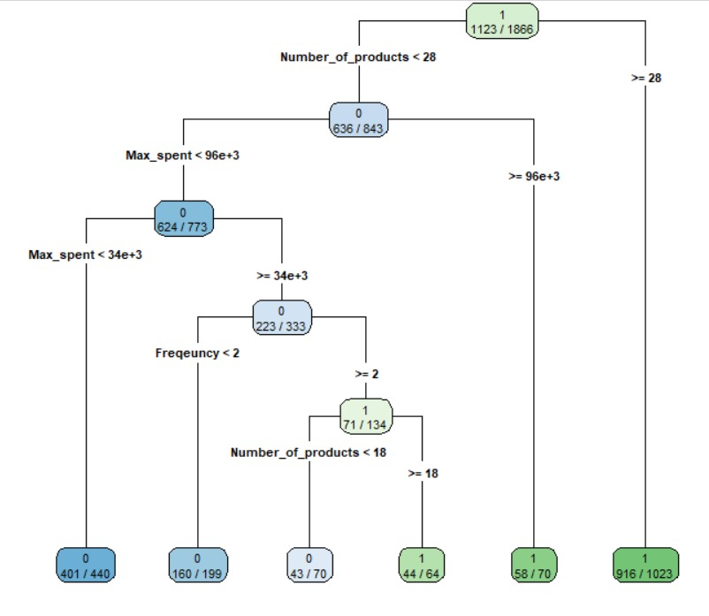
Classification Tree
CP | No of splits | Rel error | X error | X stdv
0.57738896 | 0 | 1.00000 | 1.00000 | 0.028460
0.06191117 | 1 | 0.42261 | 0.43472 | 0.021996
0.01076716 | 2 | 0.36070 | 0.39569 | 0.021181
0.00583221 | 5 | 0.32840 | 0.36339 | 0.020453
0.00403769 | 8 | 0.31090 | 0.36878 | 0.020578
0.00302826 | 9 | 0.30686 | 0.37012 | 0.020609
0.00269179 | 13 | 0.29475 | 0.36339 | 0.020453
0.00235532 | 17 | 0.28264 | 0.36608 | 0.020516
0.00224316 | 23 | 0.26649 | 0.36878 | 0.020578
0.00168237 | 29 | 0.25303 | 0.36743 | 0.020547
0.00134590 | 31 | 0.24899 | 0.37281 | 0.020671
0.00100942 | 35 | 0.24226 | 0.37281 | 0.020671

Slide 18
5
Results and Discussion

Slide 19
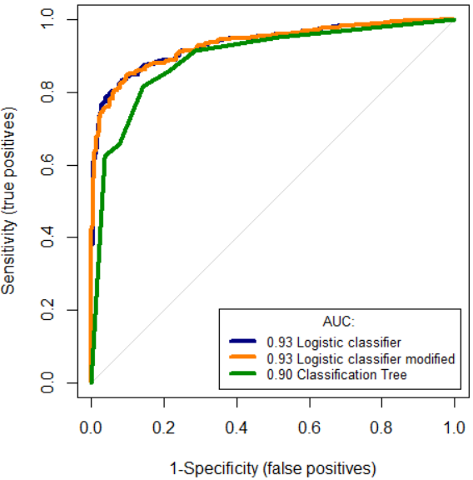
ROC Curves
Both the first and the second(modified) logistic classifiers had an AUC of 0.93
The classification tree had a lower accuracy than both logistic classifiers with an AUC of 0.9

Slide 20
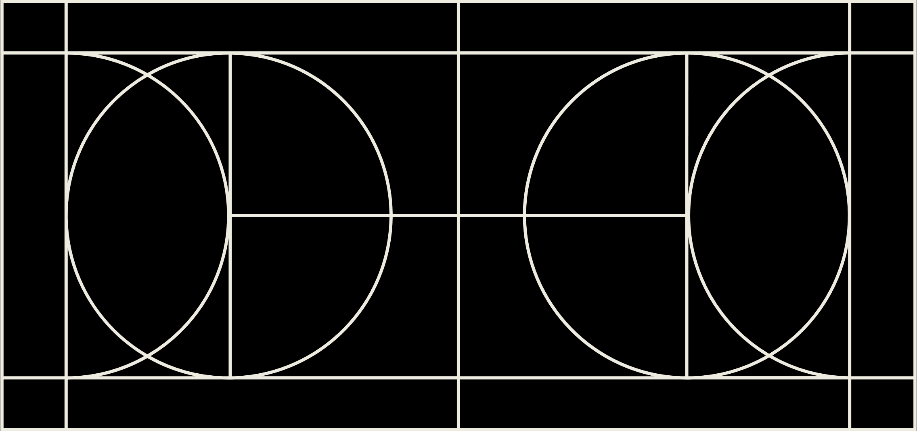
Model Performance Evaluation
Model | Sensitivity | Specificity | FPPV | FNPV | Accuracy Rate | Error Rate
Logistic Regression | 88.5 | 81.5 | 12.7 | 16.7 | 85.65 | 14.35
Modified Logistic Regression | 88.11 | 81.81 | 12.6 | 17.17 | 85.52 | 14.48
Regression Tree | 89 | 76.06 | 14.43 | 21.21 | 83.64 | 17.23

Slide 21
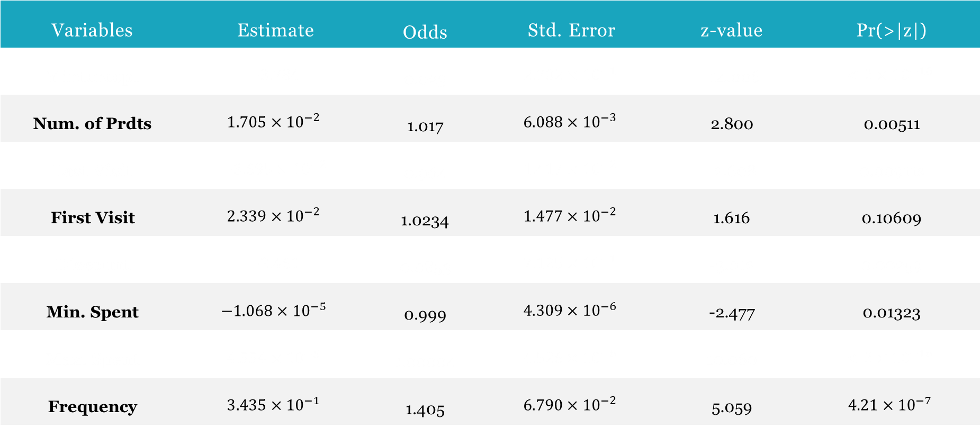
Modified Logistic Classifier Coefficients
Variables | Estimate | Odds | Std. Error | z-value | Pr(>|z|)
Y intercept | $$−3.784$$ | 0.023 | $$2.702×{10}^{−1}$$ | -14.006 | $$<2×{10}^{−16}$$
Num. of Prdts | $$1.705×{10}^{−2}$$ | 1.017 | $$6.088×{10}^{−3}$$ | 2.800 | 0.00511
Last Visit | $$−3.695×{10}^{−2}$$ | 0.964 | $$1.417×{10}^{−2}$$ | -2.608 | 0.00911s
First Visit | $$2.339×{10}^{−2}$$ | 1.0234 | $$1.477×{10}^{−2}$$ | 1.616 | 0.10609
Discount | $$−2.461$$ | 0.0853 | $$7.125×{10}^{−1}$$ | -3.012 | 0.00259
Min. Spent | $$−1.068×{10}^{−5}$$ | 0.999 | $$4.309×{10}^{−6}$$ | -2.477 | 0.01323
Max. Spent | $$4.554×{10}^{−5}$$ | 1.00004 | $$4.526×{10}^{−6}$$ | 10.060 | $$<2×{10}^{−16}$$
Frequency | $$3.435×{10}^{−1}$$ | 1.405 | $$6.790×{10}^{−2}$$ | 5.059 | $$4.21×{10}^{−7}$$

Slide 22
Recommendation System
Recommend products for similar customers
Develop a customer-customer similarity matrix
Compute cosine distances between customers
Develop a customer-product similarity matrix

Slide 23
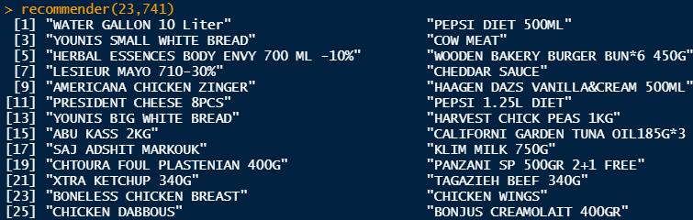
Maximum Cosines for Customers Similar to Customer of ID 23
Recommended Products
CustomerID | 23 | 741 | 70 | 760 | 2531 | 1961
23 | 1 | 0.426 | 0.329 | 0.301 | 0.273 | 0.213

Slide 24
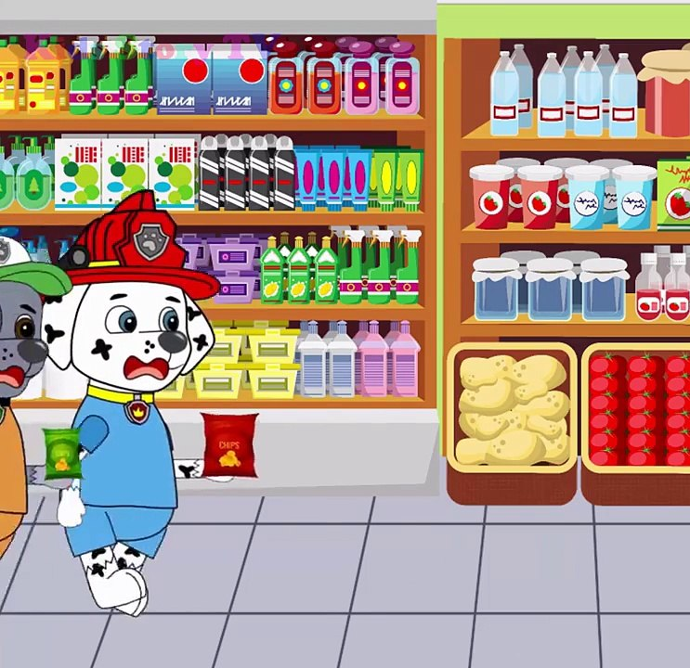
6
Conclusion and Recommendation

Slide 25
THANK YOU!

